Slide 1
Harlem Globetrotters group sales
Kaitlyn Parenteau

Slide 2
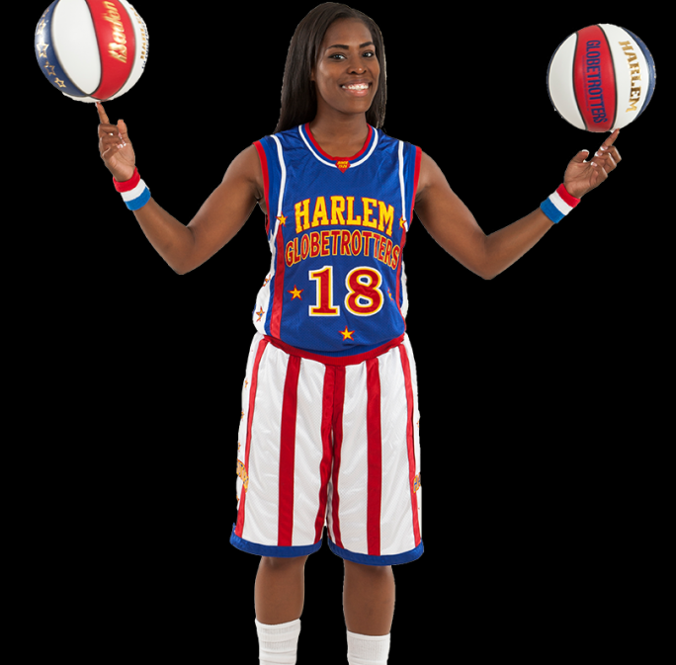
Girl Scout Cookie night
Troops will get a post show meet and greet with the players and a poster for them to sign
For every girl who sells more than 1,000 boxes of cookies they will get 2 free tickets to the March 16th show
They will also get their names and troop numbers on the Jumbo Tron during the game
Upper Bowl Side & Corner Seating - $25.00
Value- $75
A 15% discount will be given to groups of 15 or more

Slide 3
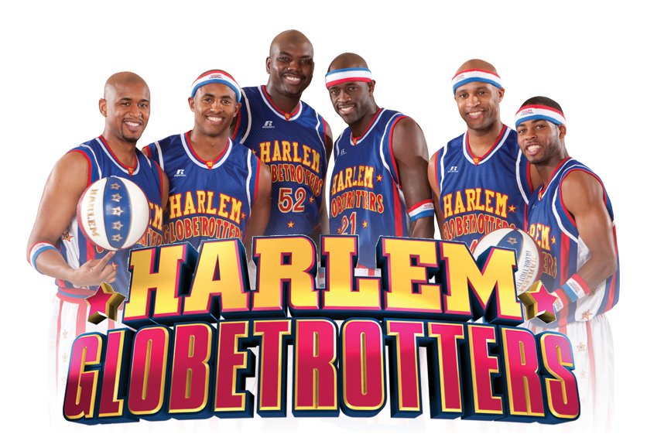
Team Night
A chance for youth basketball teams to learn new skills from the players
A pre-show scrimmage between teams
A 30 min skills clinic
A hot dog and drink with every ticket
Lower Side & End Seating - $55.00
20% off the price for groups of 15 or more
$150 value

Slide 4
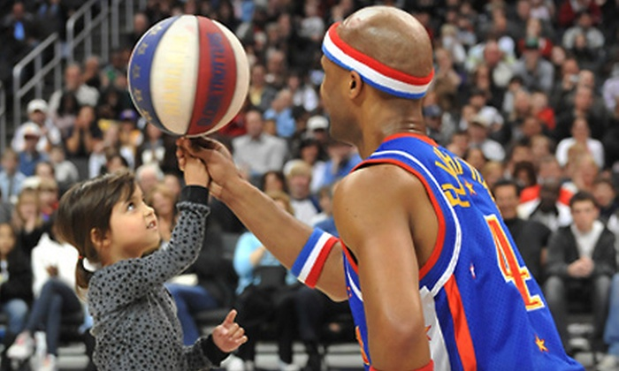
Family Premier package
A great night out for family's
Available in 4,6, and 8 ticket packages
A gift pack with a signed ball, headband, poster and a hot dog and drink for each member
VIP Floor seating
A minimum of 1 show interaction with a player
A post show meet and greet with a chance to take pictures on the court and talk to the players
A 20% discount will be given if purchased early
(cut off 1 month before show)
$600 value for 4 tickets- ($100 per tickets plus $200 for the gift pack and meet and greet)

